Slide 1
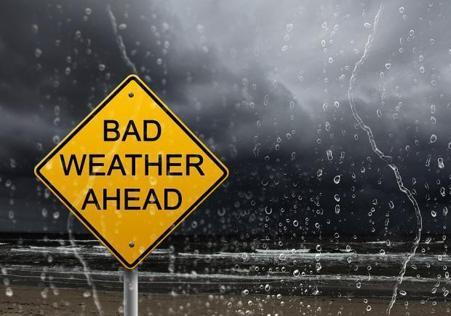

GET COVERED!
A P2P Micro- Insurance Platform
for Farmers

Slide 2
THE PROBLEM

Slide 3
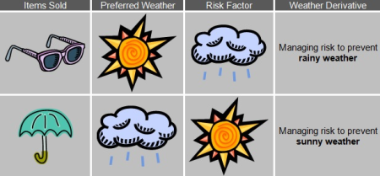
=> Weather translates into financial risk.

Slide 4
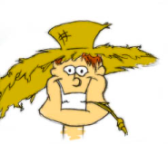
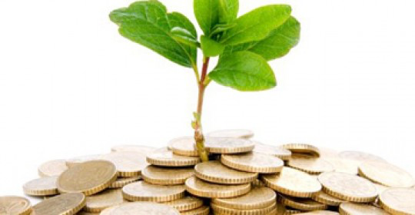
Farmers’ crop is exposed to weather risk
What can a farmer insure today
?
Insurance coverage %
DIFFICULT TO COVER
75%
too much / less sun
longer draught
EASY TO COVER
50%
hail
earthquakes
flooding
too humid soil
frost
0%
Amount of faulty /unwanted weather conditions

Slide 5
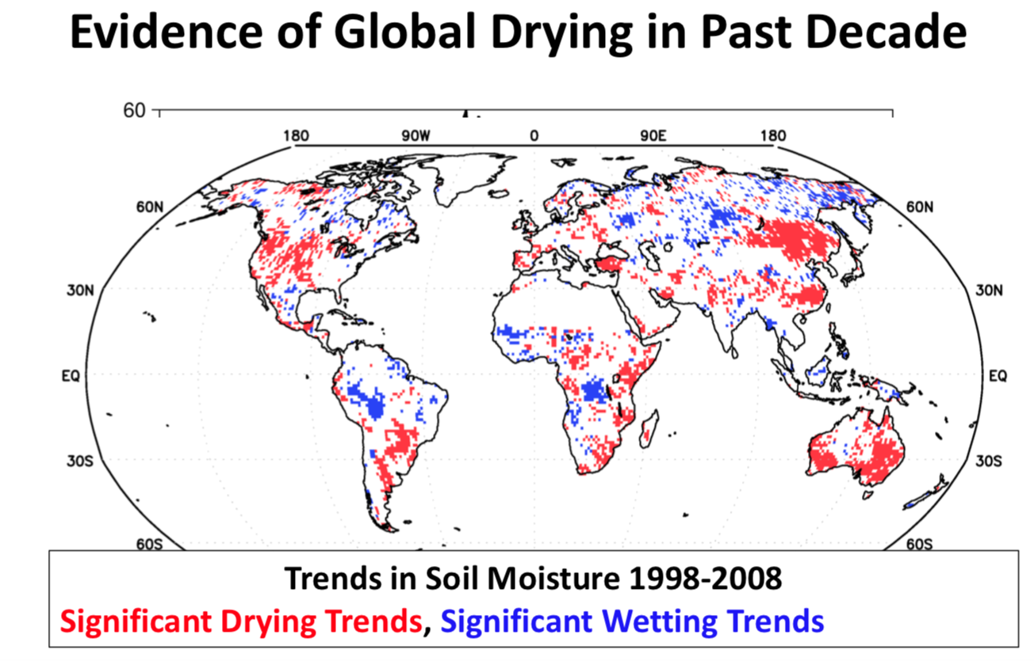

Slide 6
THE DEVICE (DATA)

Slide 7
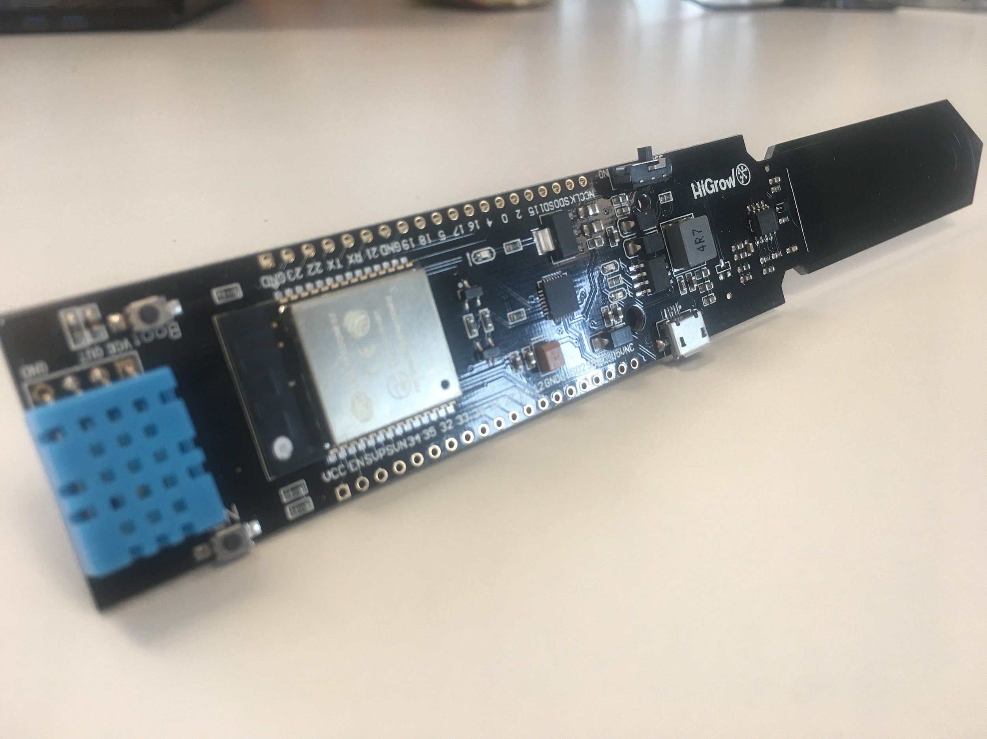
IoT HiGrow sensor
Crowdfunded project http://www.higrow.tech/en/
Enables measuring of
Temperature
Air Humidity
Soil Humidity
Rain Fall amount
Powered by battery, autonomous with solar panel
Data-Transmission via WiFi or LoRaWan possible

Slide 8
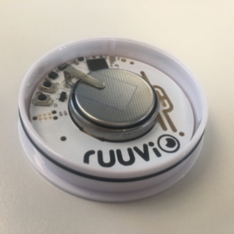
IoT Ruuvi sensor
Waterproof sensor measuring
temperature
humidity
pressure
motion
Transmission via Bluetooth
BlockChain usage anticipated:
“Ruuvi is one of the first IoT sensor companies supporting these bleeding edge technologies. We're closely cooperating with pioneers of this new industry.”

Slide 9
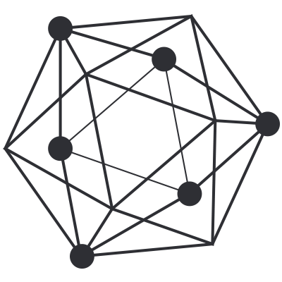
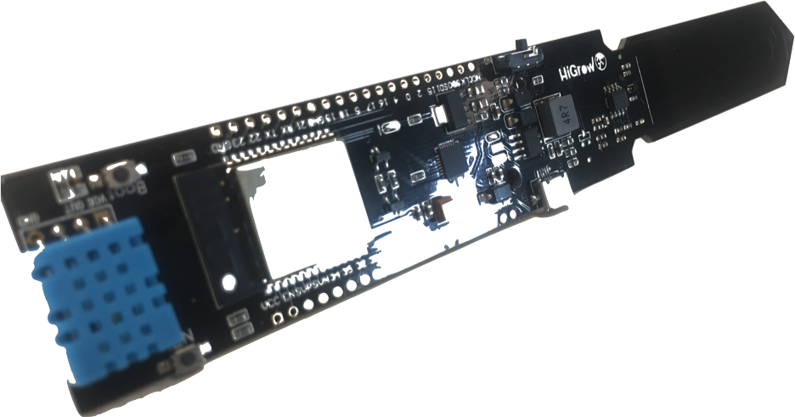
Our prototype
Data measured in real time by sensors placed on the farmer’s land
Via MQTT messages imported into IBM Cloud service and stored in Hyperledger
The distributed ledger keeps the
data points secure and trusted
Air indicators
Soil indicators

Slide 10

Data collection
After sensors have been placed, highly
granular weather data evolves
Incentive to farmers via token for data provision
=> Token will be used to pay for usage of the P2P insurance platform

Slide 11
DEMO
https://www.dropbox.com/s/d0xoeliqp2uwsx3/weatherblock.mp4?dl=0

Slide 12
THE SMART CONTRACT

Slide 13
Identification of insurance event
If indicators are “off” by a pre-set value over a pre-determined period of time, farmers may get compensated for a bad or lost harvest – a smart contract is triggered
precipitation, temperature…
20 days in August
heavy rain
too Low temperatures
Example wine grapes
Wine Grapes don‘t like too much rain
precipitation
temperature
March April Mai June July August September October

Slide 14

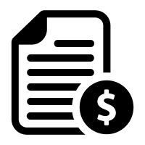
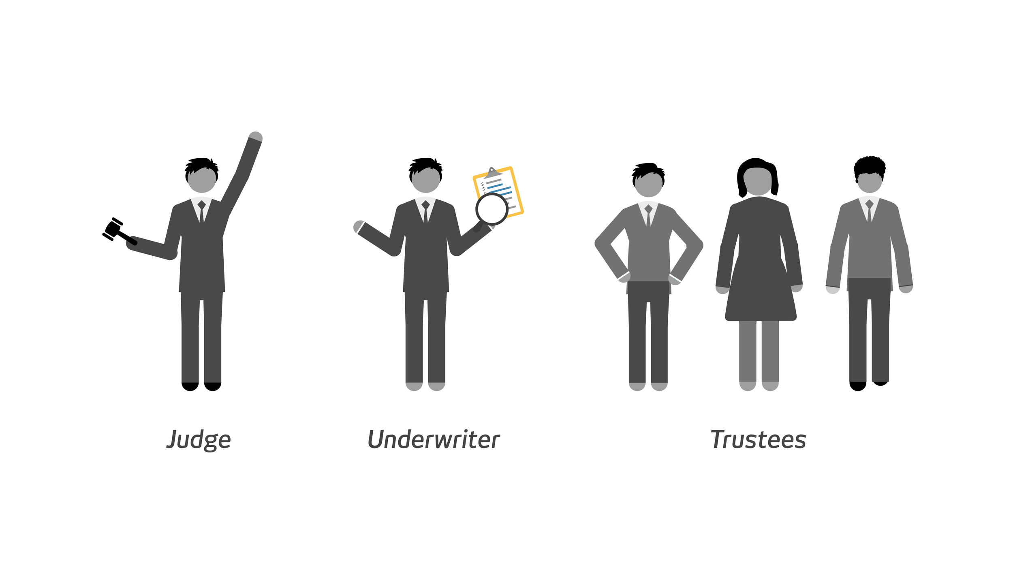


The Smart Contract
60
Farmer decides what weather event he likes to insure against. These rules will be defined in a smart contract and he pays in the related premium in the form of tokens.
Individuals (crowd) or Underwriters can contribute to the required insurance on the P2P Platform
When the required insurance amount is reached, the smart contract gets activated and the tokens of all contributers locked in the contract
1000
20
1100/3000
20
60
3000/3000

Slide 15


The Smart Contract - Execution
4. The Smart Contract continuously receives sensor data and checks if the agreed threshold will be reached
5a. If a critical event is triggered, the farmer will immediately receive the payout of all tokens locked in the smart contract
5b. If the smart contract expires without being triggered, contributors receive back their deposit plus their share of the farmer’s premium
3000
3000
The blockchain allows for
immutable trusted environment
connect multiple parties peer 2 peer
immediate settlement without paperwork

Slide 16
GO TO MARKET

Slide 17

MARKET
560 Mio. farmers worldwide
200 Bn. weather damage/year
What is covered nowadays?
only 5% of farmers have access to futures market
potential competitors focussing on public data only
What is assumed for the business case?
average 2 ha of land (80% of farmers worldwide)
1 out of 100 farmers suffers from a crop incident
average crop shortfall of 3.000 Euro for 2 ha (corn, Forex)
making a shortfall insurance 60€ (2% of harvest value, e.g. Munich Re)

Slide 18
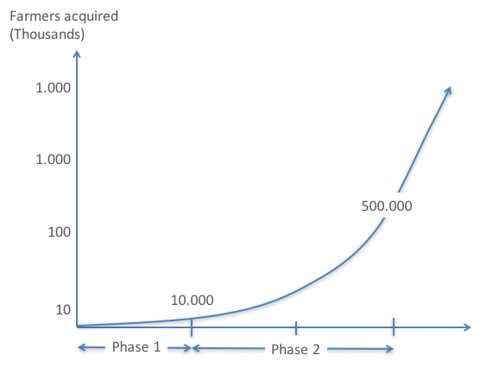
GROWTH TRACK
Continuous Business
Crowdfunding to start
Goal 1Mio. € > 10.000 Devices:
Crowdfunding Investment of
100€ each
Voucher 60 €
Device 40€
Revenue Model
Weather Block will earn from each transaction
10% from premiums 6 Euro/year
10% from insurance payout 3 Euro/year (10% x 3000/100)

Slide 19
ROADMAP
Private Investment and/or Crowdfunding
IoT Device Prototype
Reach out to Farmers (e.g. LOI with cooperatives)
Pilot Beta (on field testing)
P2P Platform working
Private Beta (crowd and selected farmers)
Public rollout with 10.000 Farmers
open to the public
500.000 farmers connected by end of 2020
Apr 2019
Aug 2018
May 2019
Dec 2018
Feb 2019
Aug 2019

Slide 20
THE TEAM

Slide 21
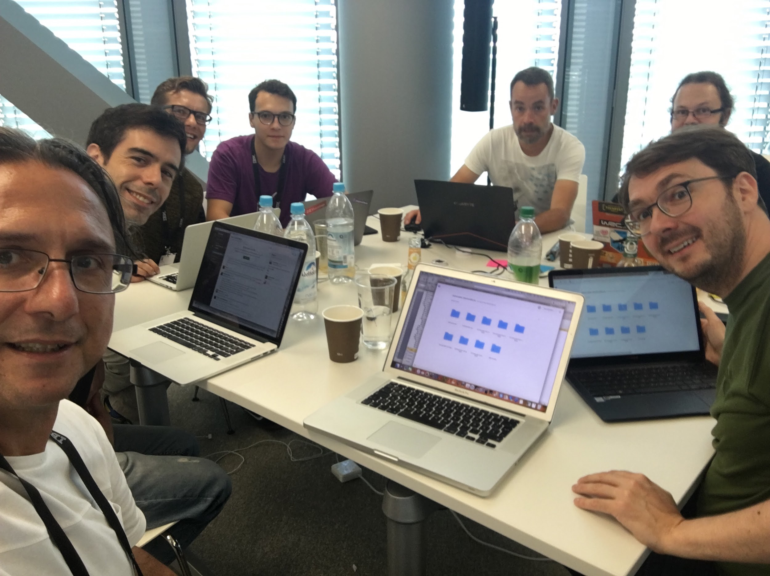
Miguel, “Painter” (Computer Engineer)
Marcelo “Machinist” (Mechatronics)
Martin “Aviator” (Mathematics)
Winand “Root2” (Computer Sciences)
Patrick “Root IdIoT” (Embedded System & Streaming)
Alexander “Aggregator”
(E-Business)
Federico “Integrator”
(Telecommunications & Manufacturing)

Slide 22
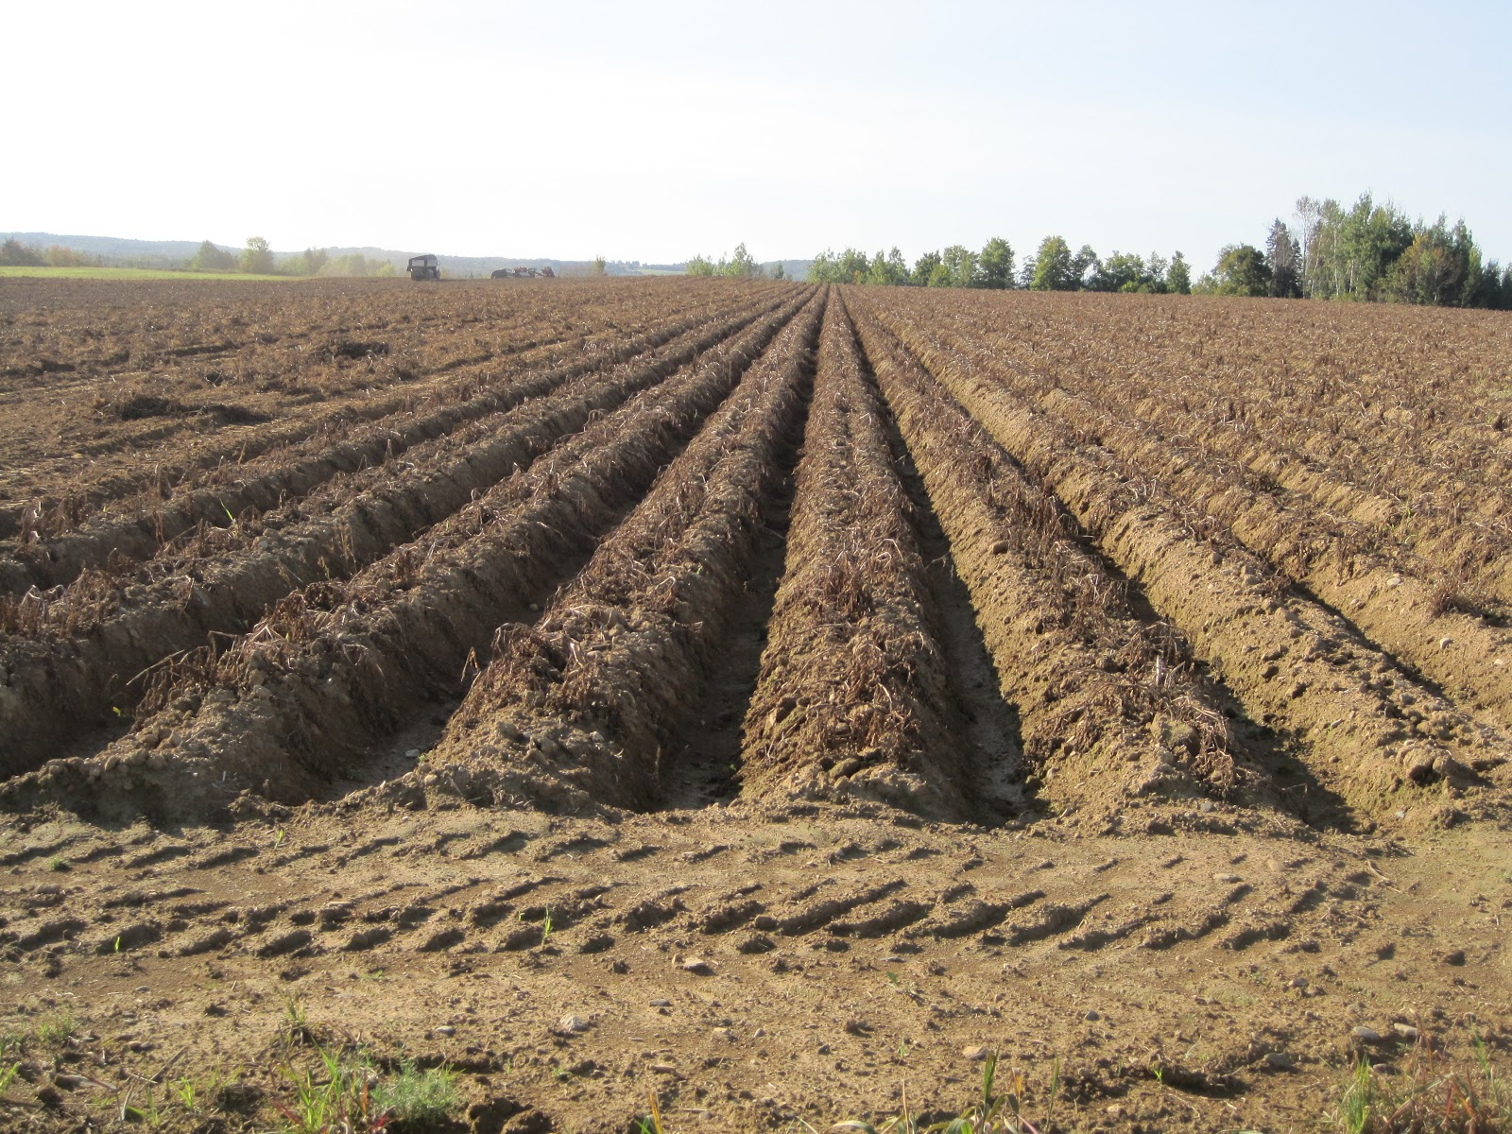
- THE END - INSURANCE PAYOUT RECEIVED SPACE FOR NEW CROPS FARMER IS HAPPY

